Slide 1
Non-regular languages
(Pumping Lemma)
2016
BLM2502 Theory of Computation – Regular Pumping

Slide 2
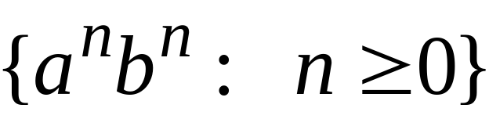
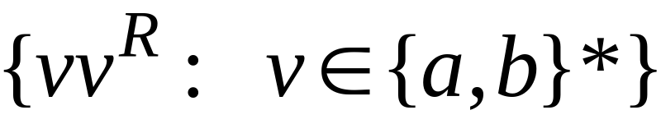


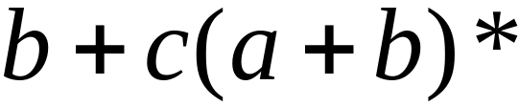

Non-regular languages
Regular languages
2016
BLM2502 Theory of Computation – Regular Pumping

Slide 3

How can we prove that a language
is not regular?
Prove that there is no DFA or NFA or RE
that accepts
Difficulty: this is not easy to prove
(since there is an infinite number of them)
Solution: use the Pumping Lemma !!!
2016
BLM2502 Theory of Computation – Regular Pumping

Slide 4

The Pigeonhole Principle
2016
BLM2502 Theory of Computation – Regular Pumping

Slide 5


pigeons
pigeonholes
2016
BLM2502 Theory of Computation – Regular Pumping

Slide 6
A pigeonhole must
contain at least two pigeons
2016
BLM2502 Theory of Computation – Regular Pumping

Slide 7



pigeons
...........
pigeonholes
...........
2016
BLM2502 Theory of Computation – Regular Pumping

Slide 8
The Pigeonhole Principle
pigeons
pigeonholes
There is a pigeonhole
with at least 2 pigeons
...........
2016
BLM2502 Theory of Computation – Regular Pumping

Slide 9
The Pigeonhole Principle and
DFAs
2016
BLM2502 Theory of Computation – Regular Pumping

Slide 10






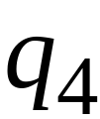


Consider a DFA with states
2016
BLM2502 Theory of Computation – Regular Pumping

Slide 11




Consider the walk of a “long’’ string:
(length at least 4)
A state is repeated in the walk of
2016
BLM2502 Theory of Computation – Regular Pumping

Slide 12
The state is repeated as a result of
the pigeonhole principle
Walk of
Pigeons:
(walk states)
Are more than
Nests:
(Automaton states)
Repeated
state
2016
BLM2502 Theory of Computation – Regular Pumping

Slide 13

Consider the walk of a “long’’ string:
(length at least 4)
Due to the pigeonhole principle:
A state is repeated in the walk of
2016
BLM2502 Theory of Computation – Regular Pumping

Slide 14
The state is repeated as a result of
the pigeonhole principle
Walk of
Pigeons:
(walk states)
Are more than
Nests:
(Automaton states)
Automaton States
Repeated
state
2016
BLM2502 Theory of Computation – Regular Pumping

Slide 15
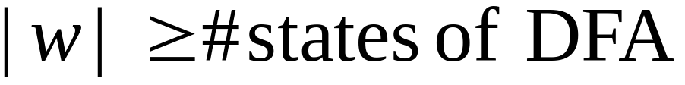

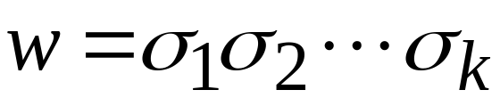












In General:
If ,
by the pigeonhole principle,
a state is repeated in the walk
Walk of
....
....
....
Arbitrary DFA
......
......
Repeated state
2016
BLM2502 Theory of Computation – Regular Pumping

Slide 16
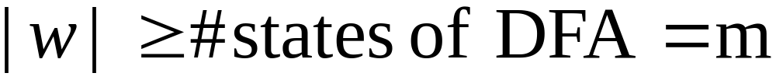

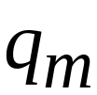

Walk of
Pigeons:
(walk states)
....
....
....
Are
more
than
....
....
Nests:
(Automaton states)
A state is
repeated
2016
BLM2502 Theory of Computation – Regular Pumping

Slide 17
The Pumping Lemma
2016
BLM2502 Theory of Computation – Regular Pumping

Slide 18

Take an infinite regular language
(contains an infinite number of strings)
There exists a DFA that accepts
states
2016
BLM2502 Theory of Computation – Regular Pumping

Slide 19

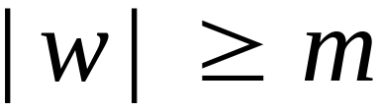
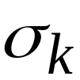

Take string with
(number of
states of DFA)
then, at least one state is repeated
in the walk of
Walk in DFA of
......
......
Repeated state in DFA
2016
BLM2502 Theory of Computation – Regular Pumping

Slide 20

There could be many states repeated
Take to be the first state repeated
One dimensional projection of walk :
First
occurrence
Second
occurrence
....
....
....
Unique states
2016
BLM2502 Theory of Computation – Regular Pumping

Slide 21


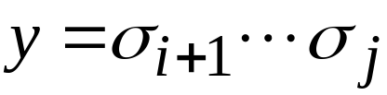
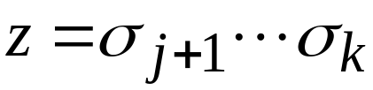
We can write
One dimensional projection of walk :
First
occurrence
Second
occurrence
....
....
....
2016
BLM2502 Theory of Computation – Regular Pumping

Slide 22





In DFA:
contains only
first occurrence of
...
...
...
...
2016
BLM2502 Theory of Computation – Regular Pumping

Slide 23


Observation:
length
number
of states
of DFA
...
Unique States
...
Since, in no
state is repeated
(except q)
2016
BLM2502 Theory of Computation – Regular Pumping

Slide 24

Observation:
length
Since there is at least one transition in loop
...
2016
BLM2502 Theory of Computation – Regular Pumping

Slide 25
We do not care about the form of string
may actually overlap with the paths of and
...
...
2016
BLM2502 Theory of Computation – Regular Pumping

Slide 26

Additional string:
The string
is accepted
Do not follow loop
...
...
...
...
2016
BLM2502 Theory of Computation – Regular Pumping

Slide 27

Additional string:
The string
is accepted
Follow loop
2 times
...
...
...
...
2016
BLM2502 Theory of Computation – Regular Pumping

Slide 28

Additional string:
The string
is accepted
Follow loop
3 times
...
...
...
...
2016
BLM2502 Theory of Computation – Regular Pumping

Slide 29
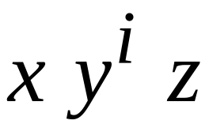


In General:
The string
is accepted
Follow loop
times
...
...
...
...
2016
BLM2502 Theory of Computation – Regular Pumping

Slide 30
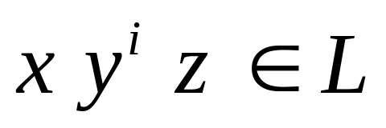
Therefore:
Language accepted by the DFA
...
...
...
...
2016
BLM2502 Theory of Computation – Regular Pumping

Slide 31
In other words, we described:
The Pumping Lemma !!!
2016
BLM2502 Theory of Computation – Regular Pumping

Slide 32


The Pumping Lemma:
Given a infinite regular language
there exists an integer
(critical length)
for any string with length
we can write
with and
such that:
2016
BLM2502 Theory of Computation – Regular Pumping

Slide 33
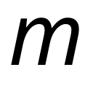
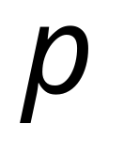
In the book:
Critical length = Pumping length
2016
BLM2502 Theory of Computation – Regular Pumping

Slide 34
Applications of the Pumping Lemma
2016
BLM2502 Theory of Computation – Regular Pumping

Slide 35
Observation:
Every language of finite size has to be regular
(we can easily construct an NFA
that accepts every string in the language)
Therefore, every non-regular language
has to be of infinite size
(contains an infinite number of strings)
2016
BLM2502 Theory of Computation – Regular Pumping

Slide 36

Suppose you want to prove that
An infinite language is not regular
1. Assume the opposite: is regular
2. The pumping lemma should hold for
3. Use the pumping lemma to obtain a
contradiction
4. Therefore, is not regular
2016
BLM2502 Theory of Computation – Regular Pumping

Slide 37


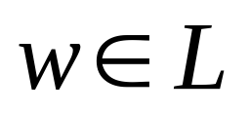
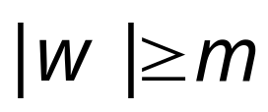
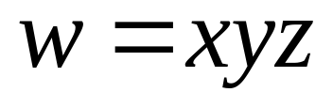
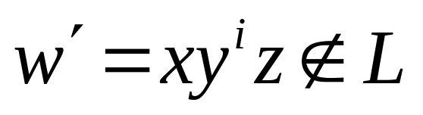
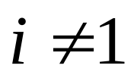
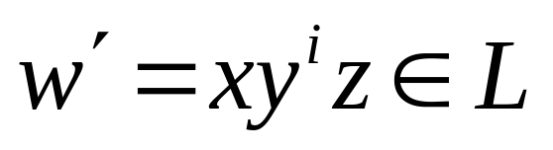
Explanation of Step 3: How to get a contradiction
1. Let be the critical length for
2. Choose a particular string which satisfies
the length condition
3. Write
4. Show that
for some
5. This gives a contradiction, since from
pumping lemma
2016
BLM2502 Theory of Computation – Regular Pumping

Slide 38

Note:
It suffices to show that
only one string
gives a contradiction
You don’t need to obtain
contradiction for every
2016
BLM2502 Theory of Computation – Regular Pumping

Slide 39

Example of Pumping Lemma application
Theorem:
The language
is not regular
Proof:
Use the Pumping Lemma
2016
BLM2502 Theory of Computation – Regular Pumping

Slide 40
Assume for contradiction
that is a regular language
Since is infinite
we can apply the Pumping Lemma
2016
BLM2502 Theory of Computation – Regular Pumping

Slide 41


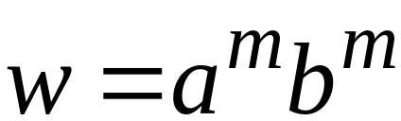
Let be the critical length for
Pick a string such that:
and length
We pick
2016
BLM2502 Theory of Computation – Regular Pumping

Slide 42
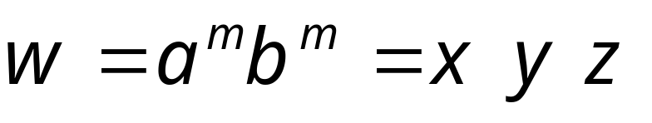

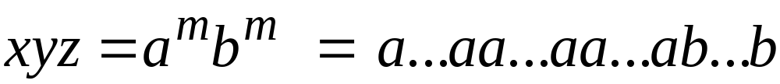

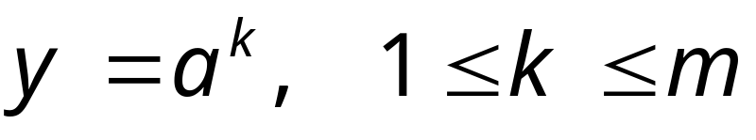
From the Pumping Lemma:
we can write
with lengths
Thus:
2016
BLM2502 Theory of Computation – Regular Pumping

Slide 43
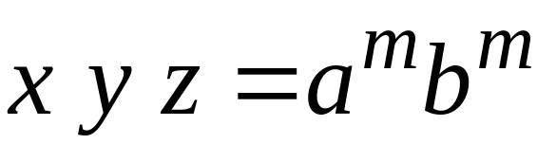

From the Pumping Lemma:
Thus:
2016
BLM2502 Theory of Computation – Regular Pumping

Slide 44

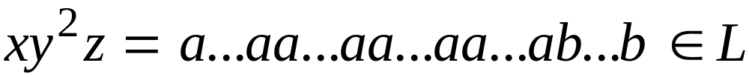
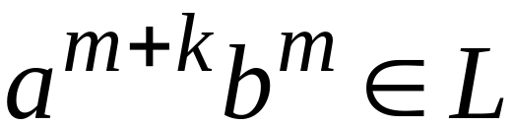
From the Pumping Lemma:
Thus:
2016
BLM2502 Theory of Computation – Regular Pumping

Slide 45
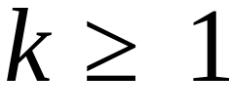
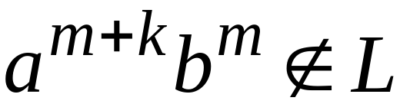
BUT:
CONTRADICTION!!!
2016
BLM2502 Theory of Computation – Regular Pumping

Slide 46
Therefore:
Our assumption that
is a regular language is not true
Conclusion:
is not a regular language
END OF PROOF
2016
BLM2502 Theory of Computation – Regular Pumping

Slide 47
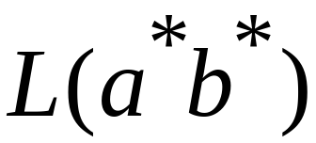
Non-regular language
Regular languages
2016
BLM2502 Theory of Computation – Regular Pumping

